Slide 1
CS2030 Exam Revision Part 2
By Jeremy Lim

Slide 2
SOLID Design Principles
Single Responsibility
Open-Closed
Liskov Substitution
Interface Segregation
Dependency Inversion

Slide 3
Single Responsibility Principle
Each class handles 1 function
Do one thing and do it well

Slide 4
Open-Closed Principle
Open for extension
Able to extend a class to add new features
Closed for modification
Don’t have to edit more than one class when adding a new feature
(Related to Single Responsibility Principle)

Slide 5
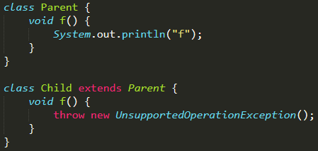
Liskov Substitution Principle
Child classes should be able to do what the parents can do
Child classes should do what the parents are expected to do
Same “Expected behaviour”
BAD

Slide 6
Interface Segregation Principle
Interface should only contain related methods
Again related to Single Responsibility Principle
Split large interfaces into smaller ones that do one thing each
E.g. Java interfaces List, Queue implemented by LinkedList
Depend on an interface, not on a class
WHERE IT IS APPROPRIATE
(Don’t add interfaces to everything)
A
uses
B
A
uses
B (interface)
implements
ConcreteB

Slide 7
Dependency Inversion Principle
Interface defined by the user class instead of by the used
Define what you need instead of define what you do
Package A
Package B
Package A
Package B
A defines what it needs
B defines what it does
A
A
uses
B (interface)
uses
implements
B (interface)
implements
ConcreteB
ConcreteB

Slide 8
Generics
Primitives auto-boxed to Objects
List<Number> list = new ArrayList<Number>(); ✔️
ArrayList<Number> list = new ArrayList<Integer>(); ❌
ArrayList<? extends Number> list2 = new ArrayList<Integer>();
List<Number> list = new ArrayList<Integer>(); ❌
List<? extends Number> list3 = new ArrayList<Integer>();

Slide 9
Generics
Producer Extends
List<? extends T> list to use T as an upper bound when list is the producer
Method takes a producer of T
Consumer Super
List<? super T> list to use T as a lower bound when list is the consumer
Method takes a consumer of T
(Also see Tutorial 8 slides)

Slide 10
Lambdas
[single parameter] -> [one-liner];
x -> x + 1;
([more than one parameter]) -> {[more than one line]};
(x, y) -> { System.out.println(x); return x + y; }
Input types optional
(Integer x, Double y) -> { System.out.println(x); return x + y; }
^ cannot do (int x, double y)
Type of lambda specified by type of variable
Lambda has to match variable
Predicate<Integer> f = x -> x.isInfinite(); ❌
^ Method of Double but not Integer

Slide 11
Common Functional Interfaces
Type | Input | Output
Function | ⭕️ | ⭕️
Predicate | ⭕️ | Boolean
Supplier | ❌ | ⭕️
Consumer | ⭕️ | ❌

Slide 12
Currying
Joining multiple lambdas to get n inputs
Function & BiFunction, what about TriFunction?
x -> y -> z -> x * y + z;
Function<Integer, Function<Integer, Function<Integer, Integer>>> f
f.apply(2).apply(3).apply(4)

Slide 13
Anonymous Classes
[variable] = new SomeInterface {…}
[variable] = new SomeClass {…}
Usually used with either interfaces or abstract classes
{…}: Implement abstract methods or override existing methods
When SomeInterface is a functional interface, and {…} implements the abstract method, that is equivalent to writing a lambda

Slide 14


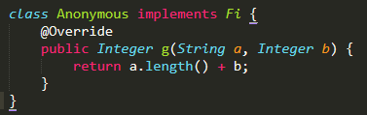

Anonymous Class $≡$ Lambda (For Functional Interfaces)
Remember the access modifier!
Possible to write a lambda as an anonymous class (Possible exam qns)

Slide 15
Anonymous class Variable Capture
int someVar = 3; Fi anon = new Fi() {…}
Variables must be effectively final to be captured
Either declared with final keyword or does not change once initialised
int otherVar; otherVar = 3;
This is NOT effectively final
Final means value must be set at declaration
anon has access to someVar and can use it inside

Slide 16
Bye 😢
Updated revision slides will be sent to you
Attend next week’s wed/thurs tut if you want to go through the last tut
Email any questions (long lists are fine, no paiseh)
Please like and subscribe provide teaching feedback online!
See you next year!

